Slide 1
Software engineering (Undergraduate)
Chapter 8
feature driven development (fdd)
Course Name
software engineering
CSC 3114
(Undergraduate)
MD RAIHAN MAHMUD
Lecturer, CS, AIUB
raihan.mahmud@aiub.edu

Slide 2
What is fdd?
Slide-2
Feature Driven Development (FDD)
FDD is an agile software development process
FDD uses a short-iteration model
FDD combines key advantages of other popular agile approaches along with other industry-recognized best practices
FDD was created to easily scale to much larger projects and teams
RM

Slide 3
What is a feature?
Slide-3
FDD delivers the system feature by feature
Feature is a small function expressed in client-valued terms which presents the customer requirements to be developed in software using small iteration
Features are to be “small” in the sense they will take no more than two weeks to complete Features that appear to take longer are to be broken up into a set of smaller features. Two weeks is the maximum, most features take less time (1 - 5 days)
Feature naming template:
<action> the <result> <by|for|of|to> a(n) <object> Calculate the vote of a national election
Examples: Calculate the total of a sale
Validate the password of a user
Authorize the sales transaction of a customer
RM

Slide 4
Fdd roles
Slide-4
FDD Primary Roles
FDD Supporting Roles
Project Manager | Chief Architect
Class Owners | Domain Experts
 | Chief Programmers
Language Guru (shared vocabulary)
Toolsmith (making tools for application)
Tester
Technical Writer (documentation)
RM

Slide 5
Fdd process
Slide-5
Process #1: Develop an Overall Model
Process #2: Build a Features List
Process #3: Plan By Feature
Process #4: Design By Feature
Process #5: Build By Feature
RM

Slide 6
Fdd process
Slide-6
Project wide upfront design activities:
  Process #1: Develop an Overall Model
  Process #2: Build a Features List
  Process #3: Plan By Feature
  Goal: not to design the system in its entirety but instead is to do just enough initial design that you are able to build on
Deliver the system feature by feature:
  Process #4: Design By Feature
  Process #5: Build By Feature
  Goal: Deliver real, completed, client-valued function as often as possible
RM

Slide 7
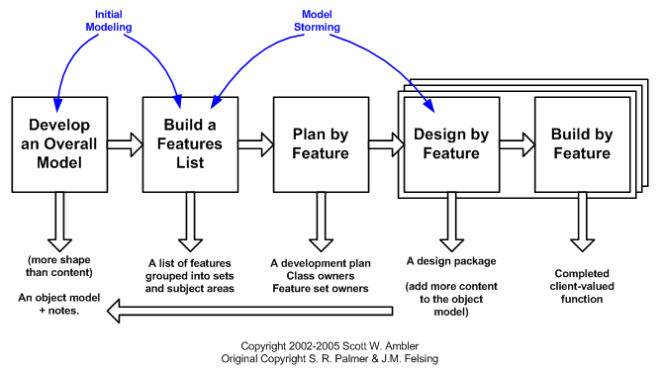
Fdd process
Slide-7
RM

Slide 8
Fdd process
Slide-8
Process #1: Develop an Overall Model
  Form a modeling team
  Domain walk-through
  Build High-level object model
  Record Notes
  Goal - for team members to gain a good, shared understanding of the problem domain and build
  a foundation
Process #2: Build a Features List
  All Features are organized in a three level hierarchy :
    Domain Subject Area
      Business Activity
        Features
RM

Slide 9
Fdd process
Slide-9
Process #3: Plan by Feature
  Construct initial schedule
    Formed on level of individual features
      Prioritize by business value
      Also consider dependencies, difficulty, and risks
  Assign responsibilities to team members
    Determine Class Owners
    Assign feature sets to chief programmers
RM

Slide 10
Fdd process
Slide-10
Process #4: Design by Feature
Form Feature Teams
Team members collaborate on the full low level analysis and design
Certain features may require teams to bring in domain experts
Teams need to update the model artifact to support their changes
Feature Team
Chief Programmers pick teams based on the current feature in development
Chief Programmers lead picked team (usually 3 to 5 people)
Upon completion of the current feature the team diRMands
Each team will concurrently work on their own independent iteration
Possible to be on multiple teams at once
RM

Slide 11
Fdd process
Slide-11
Process #5: Build by Feature
  Implement designed feature
  Test feature
    Unit-level
    Feature-level
  Mandated Code Inspections (formal review with checklist)
  Integrate with regular build
RM

Slide 12
Fdd process
Slide-12
Mandated Code Inspections for Two Main Reasons
  Research has shown that when it is done properly, inspections find more bugs as well as different types of bugs than any other form of testing.
  It is also a great learning experience
Reporting
  FDD emphasizes the ability to provide accurate, meaningful, and timely progress information to all
  stakeholders within and outside the project
  Feature Milestones
RM

Slide 13
references
Slide - 13
R.S. Pressman & Associates, Inc. (2010). Software Engineering: A Practitioner’s Approach.
Kelly, J. C., Sherif, J. S., & Hops, J. (1992). An analysis of defect densities found during software inspections. Journal of Systems and Software, 17(2), 111-117.
Bhandari, I., Halliday, M. J., Chaar, J., Chillarege, R., Jones, K., Atkinson, J. S., & Yonezawa, M. (1994).
In-process improvement through defect data interpretation. IBM Systems Journal, 33(1), 182-214.
RM

